Slide 1

7 Lost Principles of Continuous Delivery

Slide 2
It’s not about “can we build it?”, it’s about “should we build it?”

Slide 3
1.
Create a repeatable and reliable process
For releasing software

Slide 4
BIG Question
“How long would it take your organization to deploy a change that involves just one single line of code?”
Notes:
Ask yourself, “How long would it take your organization to deploy a change that involves just one single line of code?”

Slide 5


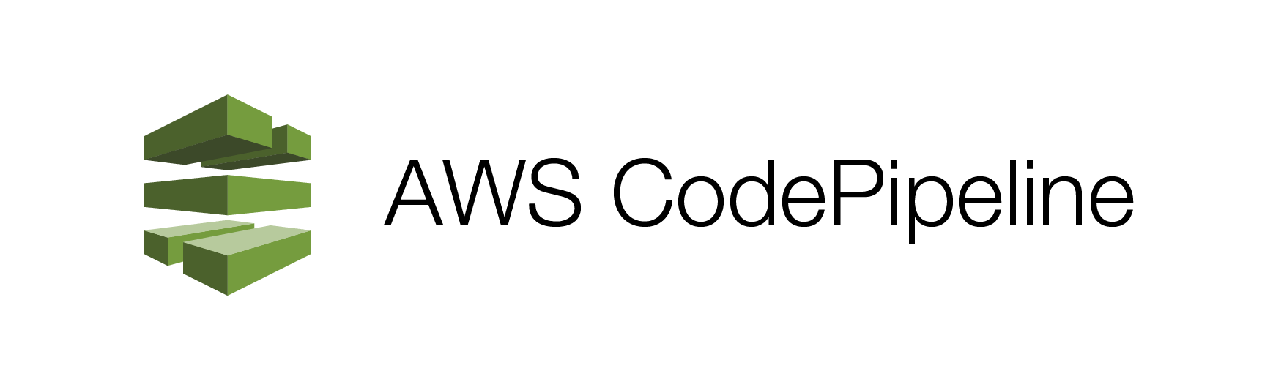
The underlying purpose
Notes:
We live in a world where shortened release cycles are a necessity. With agile development practices and continuous integration (CI), it is imperative for teams to have access to a stable tool which can manage the process of building, testing and deploying software as changes are made.
For a long time, Jenkins has been the tool of choice among developers, but as many companies have moved into the cloud, and in particular, AWS ecosystem, other tools such as Bamboo, AWS CodePipline, Go CD are gaining traction. The underlying purpose of these tools remains the same — to release your software.

Slide 6
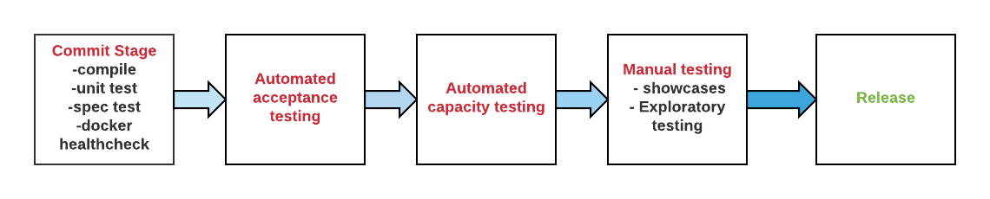
Every commit -> Source Control
Change
Release Candidate
Notes:
Every change committed to source control triggers the creation of a new instance of the pipeline. We call this a release candidate. If the release candidate passes all the tests, it can be released.

Slide 7
Deploying through the pipeline
BUILD
INSTALL
CONFIG
3 Main Phases

Slide 8
Repeatable Process
Building the infrastructure
Provisioning and managing the environment in which your software will run
Installing the software and its dependencies
Installing the correct version of the software into the infrastructure
Setting up configuration for software
Configuring your software and database, including any data or state it requires
Notes:
Deploying through the pipeline involves three main phases:
Building the infrastructure — provisioning and managing the environment in which your software will run
Installing the software and its dependencies — installing the correct version of the software into the infrastructure
Setting up configuration for software — configuring your software and database, including any data or state it requires

Slide 9


The key in such a transition to continuous delivery is to expect things to get worse before you’ll be able to make them better.” — Matthias Marscha
Notes:
The key in such a transition of continuous delivery is to expect things to get worse before you will be able to make them better

Slide 10
2. Automate, if possible, everything
Notes:
Automation is a prerequisite for the deployment pipeline because it is only through automation that we can guarantee that people will get what they need at the push of the button.

Slide 11
“The most powerful tool we have as developers is automation” - Scott Hanselman
Notes:
“The most powerful tool we have as developers is automation.” — Scott Hanselman

Slide 12

Not automating -creating a manual one
Manual steps - requires communication
Path gets wider - original set of instruction
Misinterpreted
Miscommunicated
Not maintained
Notes:
When you’re not automating the process, you’re creating manual one. These manual steps usually require communication from a person to another. As the path of communication gets wider, the original set of instructions or documentation are misinterpreted, miscommunicated, and not maintained.

Slide 13
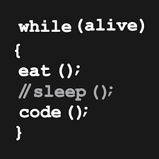
Computers - better at running repetitive task accurately
Scripts to automate any manual process in our release process
Commit automation script
Others to collaborate
Improve process
Notes:
Computers, on the other hand, are way better at running repetitious tasks accurately. We should write scripts to automate any manual process in our release process. Commit the automation script in source control for other developers to collaborate and improve the process.

Slide 14
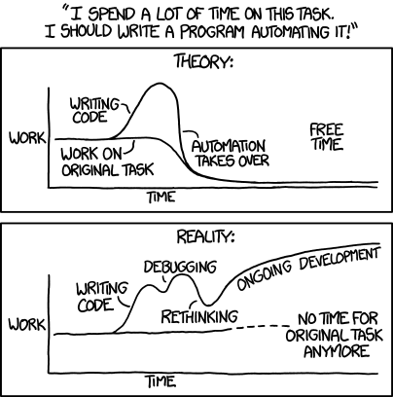

Slide 15
What to automate? When to stop?
Before we automate - ask yourself
Should go back to the drawing board
List steps - make process shorter & faster compared to manual process
Otherwise …
If you process are bad/flawed - making bad processes happen faster
Notes:
Automation is about taking once manual processes and placing technology around them so they’re inherently repeatable. Before we automate a process, we should go back to the drawing board and list the steps that would make the automated process shorter and faster compared to the manual process.Otherwise, if your processes are bad or flawed, then you’re just making bad processes happen faster.

Slide 16
Automation will ultimately improve production velocity and quality.

Slide 17
3. Keep everything under version control

Slide 18
Version Control
Everything - not just software code
Not about having backups (side effect)
About documenting & annotating -process of creation
Notes:
Everything should be committed into source control, not just your software code. Version control isn’t all about having backups. That is only a side effect.Version control is about documenting and annotating the process of creation, and it is uniquely necessary for programming because of how eternally iterative programming is.

Slide 19
Code that is not annotated with its history and its motivations suffers to an extreme degree of entropy, becoming more and more difficult to understand.
Notes:
Code that is not annotated with its history and its motivations suffers to an extreme degree of entropy, becoming more and more difficult to understand.

Slide 20
Configuration
Lifecycle completely different than of code
Sensitive information don’t checkin
Config information
Modular
Encapsulated
No knock-on effect - unrelated configuration
Notes:
Configuration settings have a lifecycle completely different from that of code, while passwords and other sensitive information should not be checked into version control. Ensure that your configuration information is modular and encapsulated so that changes in one place don’t have knock-on effects for other, unrelated pieces of configuration.

Slide 21
Configuration
Be minimalistic (simple & focused)
“Requirement” document
Deployment script
Db creation
And other similar examples
Relevant version should be identifiable for any given build
Build number/ change set number - that references every piece
Notes:
Be minimalistic. Keep the configuration information as simple and focused as possible. This includes ‘requirement’ documents, test scripts, automated test cases, network configuration scripts, deployment scripts, database creation, database maintenance scripts, technical documentation and so on. These scripts should be version-controlled, and the relevant version should be identifiable for any given build — these change sets should have a single identifier, such as a build number or version control change set number, that references every piece.

Slide 22

ASK YOURSELF

Slide 23
Could you completely re-create your live environment (like production), excluding production date, from scratch with the version-controlled assets that you store?
Notes:
Could you completely re-create your live environment (like production), excluding production date, from scratch with the version-controlled assets that you store?

Slide 24
Can you regress to an earlier, known good state of your application?
Notes:
Can you regress to an earlier, known good state of your application?

Slide 25
4. If it hurts, do it more often — bring the pain forward

Slide 26

Don’t do it at the end
Do it continually from the beginning
Application and build scripts need testing
So do your configuration settings
References to external - are good
Notes:
If testing is a painful process that occurs just before release, don’t do it at the end. Instead, do it continually from the beginning of the project. In the same way that your application and build scripts need testing, so do your configuration settings. Ensure that references to external services in your configuration settings are good.

Slide 27
At a minimum
Unit Test
Run periodically
Often after every change
Sooner - catch problem
Component Test
specific module or program
isolation from rest of the system depending on the life cycle model
like unit testing - uses real data instead of dummy data for testing
Acceptance Test
criteria decided by the business
capacity, functionality, availability, scalability, and security
Notes:
Unit tests —this involves breaking your software into pieces and subjecting each piece to a series of tests. Tests are usually run periodically, often after every change to the source code. The more often the better, because the sooner you will catch problems.
Component test — this involves testing of specific module or program. It may be done in isolation from rest of the system depending on the life cycle model selected for that particular application. Component testing is like unit testing with the difference that the developer uses real data instead of dummy data for testing of the written code.
Acceptance test — is the test that the application meets. The acceptance criteria decided by the business — capacity, functionality, availability, scalability, and security

Slide 28
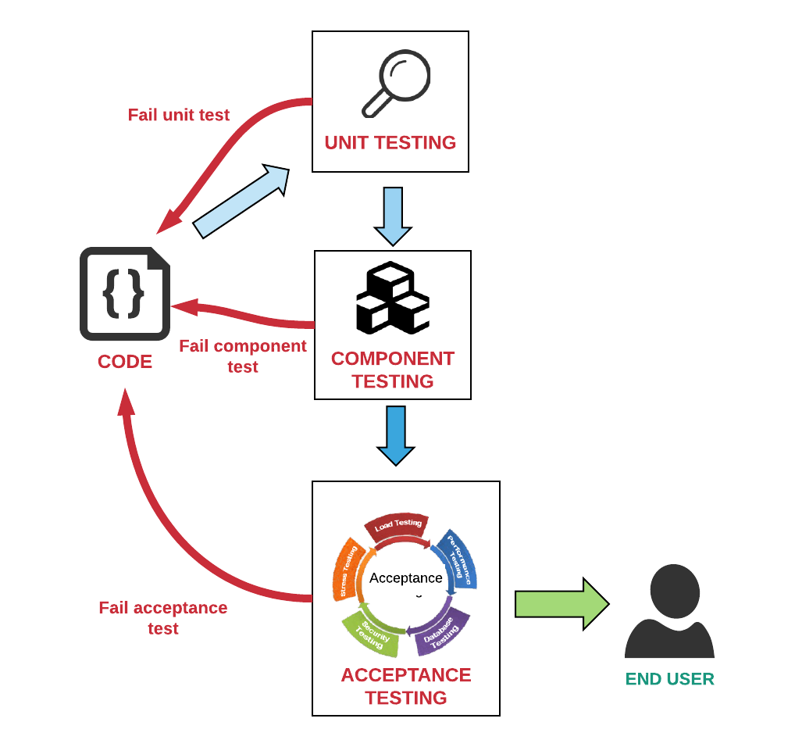

Slide 29

Don’t comment out failing test. Delete it if it’s not relevant or refactor the test.
Notes:
Don’t comment out failing test. Delete it if it’s not relevant or refactor the test.

Slide 30
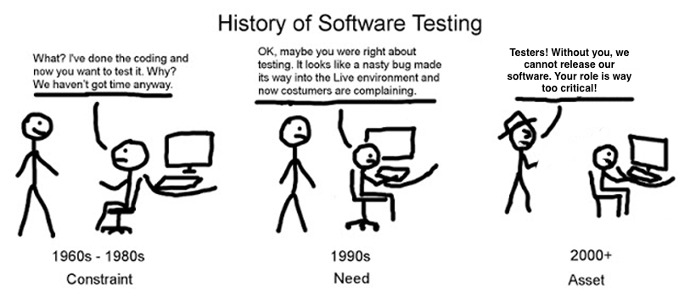

Slide 31
5. Keep the build and test process short

Slide 32

Longer - development team has to make incorrect assumption
longer it will take them to fix it
Speed is essential
opportunity cost associated with not delivering software
Verify whether - features & bug fixes are really useful
Important part of usefulness is quality
fit for its purpose
Quality does not equal perfection
Notes:
The longer the release cycle, the longer the development team has to make incorrect assumptions before the deployment occurs, and the longer it will take them to fix it.
Speed is essential because there is an opportunity cost associated with not delivering software. Delivering fast is also important because it allows you to verify whether our features and bug fixes are really useful.

Slide 33
“The perfect is the enemy of the good” — Voltaire.
Notes:
An important part of usefulness is quality. Our software should be fit for its purpose. Quality does not equal perfection.

Slide 34
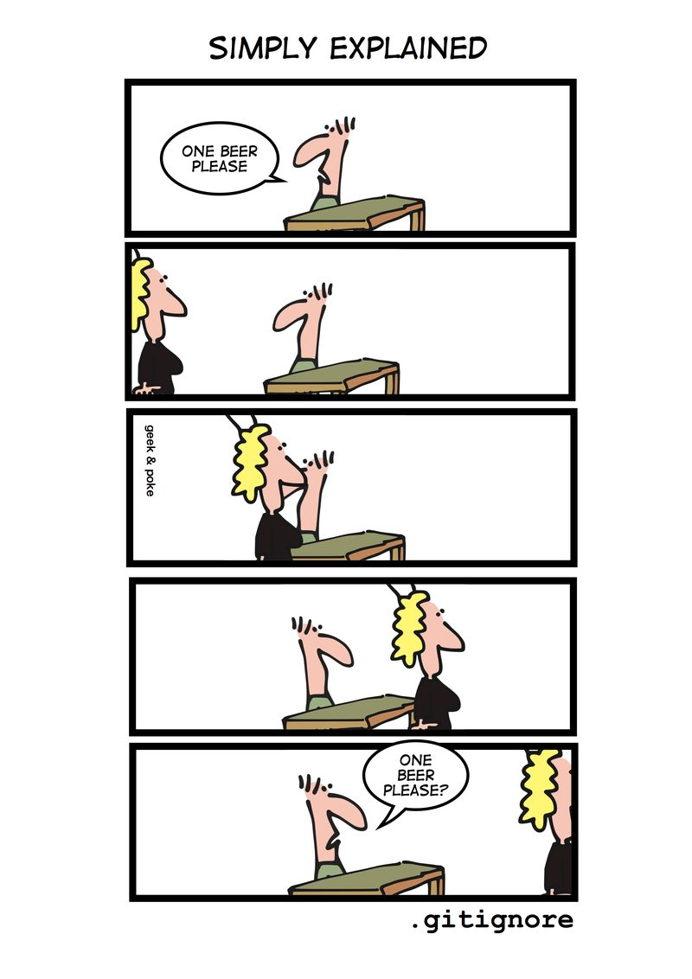
Our goal
Deliver software of sufficient quality
Bring value to its users
Check-in frequently
Least check-in your code a couple of times a day
Notes:
Our goal should always be to deliver software of sufficient quality to bring value to its users. Check-in frequently. You should at least check-in your code a couple of times a day.

Slide 35
If the build takes too long
Multiple commits would have taken place
won’t know which check-in broke the build
Build output
inform - commit that triggered the build
Developers will check in less often
have to sit around for ages waiting - build, test and deploy
Notes:
If the build takes too long, multiple commits would have taken place — you won’t know which check-in broke the build. Your build output should inform you the commit that triggered the build.
If the build process is too long, developers will check in less often because they have to sit around for ages waiting for the software to build, test and deploy.

Slide 36

WAIT
Remember
Tests to pass before moving forward
Don’t compound the failure - more problems
Remember, build a little, test a little, deploy a little.
Notes:
We should wait for tests to pass before moving forward. That way we don’t compound the failure with more problems. Remember, build a little, test a little, deploy a little.

Slide 37

Don’t
Check-in on a broken build
Cardinal sin of continuous integration
If continue -
much longer for the build to be fixed
added more complexity to the problem
Notes:
Don’t check-in on a broken build. This is the cardinal sin of continuous integration. If you continue to do so, it will take much longer for the build to be fixed, because you added more complexity to the problem.

Slide 38
Test locally on your machine before checking in your code.
Notes:
Test locally on your machine before checking in your code.

Slide 39

Never go home on a broken build
Notes:
Never go home on a broken build.

Slide 40
For example, at 5:30 pm on a Friday, all your colleagues are leaving the office and you are itching to leave as well. You decide to check-in your code and leave. Your checked in code triggers a build and it fails. What do you do next?
Notes:
For example, at 5:30 pm on a Friday, all your colleagues are leaving the office and you are itching to leave as well. You decide to check-in your code and leave. Your checked in code triggers a build and it fails. What do you do next? You have two options:

Slide 41
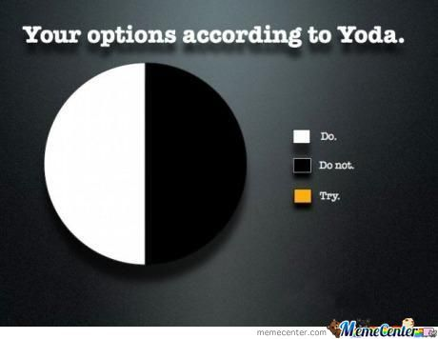
You have two options:
Revert the commit to a working version
Always be prepared to revert to the previous revision
Fix the broken test and build before you leave the door
Notes:
revert the commit to a working version. Always be prepared to revert to the previous revision.
fix the broken test and build before you leave the door.

Slide 42

If the build is broken...
Feedback loop should be fast and efficient
Notify the appropriate people - look at build
Heart of any software delivery process
Best way to improve feedback
feedback cycle short and the result visible
Notes:
If the build is broken, the feedback loop should be fast and efficient. It should notify the appropriate people to look at the build’s failure. Feedback is at the heart of any software delivery process. The best way to improve feedback is to make the feedback cycle short and the result visible.

Slide 43
6. Make every part of the process of building, deploying, testing and releasing software visible to everybody involved

Slide 44
Improve Feedback
Improve feedback so that problems
Identified,
Resolved
As early as in the process as possible
Enable teams to deploy and release any version - software
any environment at will through a fully automated process
Notes:
Improve feedback so that problems are identified, and is resolved, as early as in the process as possible. Enable teams to deploy and release any version of their software to any environment at will through a fully automated process.

Slide 45
Who acts on feedback...
The entire team - essential that everybody - process of delivering software
Software developers
Release engineers
DevOps engineers
Database administrators
Security team
Tester
Product managers.
Notes:
The entire team must act on a feedback — it is essential that everybody involved in the process of delivering software is involved in the feedback process. This includes software developers, release engineers, DevOps engineers, database administrators, security team, tester and product managers.

Slide 46
Often the poor collaboration that causes so many problems in deployment to staging is shored up with ad-hoc phone calls, emails, and quick fixes
Notes:
Often the poor collaboration that causes so many problems in deployment to staging is shored up with ad-hoc phone calls, emails, and quick fixes.

Slide 47
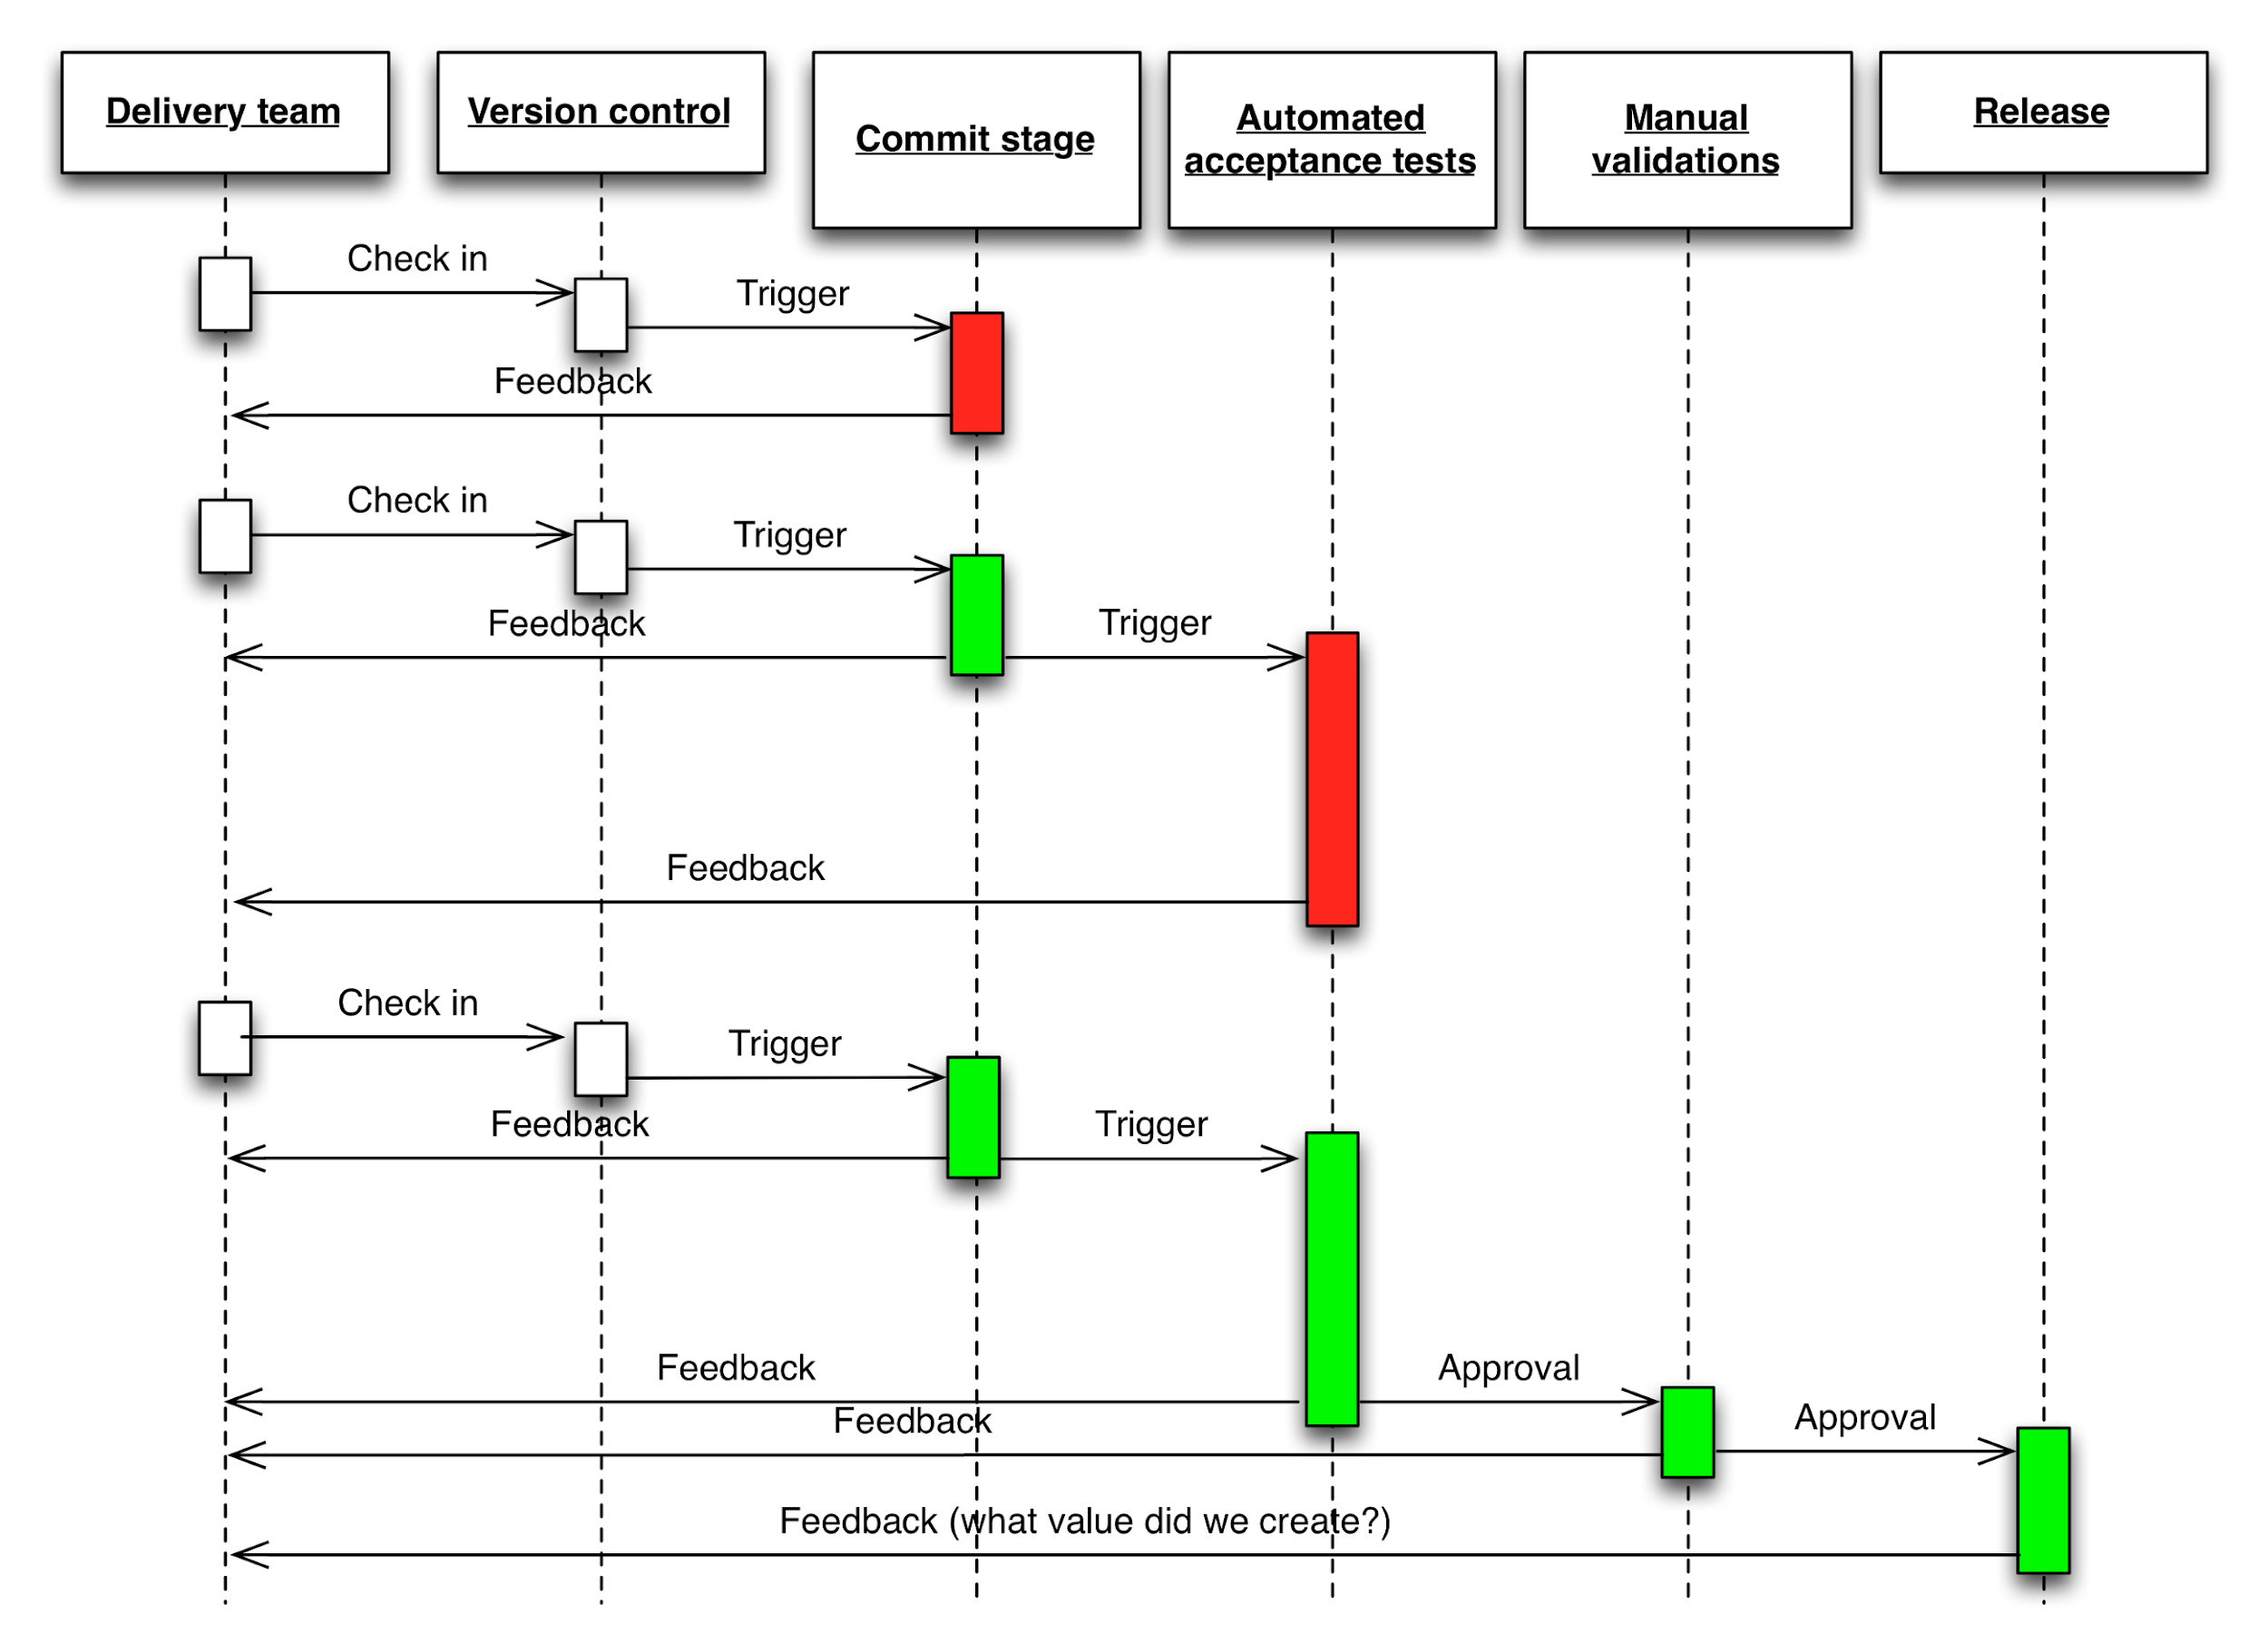
Notes:
Is it easy for team members to get the information they need and to make the changes they need to make? Or does the strategy get in the way of efficient delivery, leading to increased cycle time and reduced feedback?

Slide 48
Any changes or commits should trigger a feedback process
Delivered as soon as possible
Key? - fast feedback is automation (see point 2)
People are expensive and valuable
focused on producing software.
Notes:
Any changes or commits should trigger a feedback process — anything that changes between environment should be captured as configuration information. Feedback should be delivered as soon as possible. The key to a fast feedback is automation (see point 2). People are expensive and valuable, they should be focused on producing software.

Slide 49
7. Done Means Released

Slide 50
“done” doesn’t really mean “DONE!”
It just means developed!
X necessarily tested
Certainly X styled
X accepted by the product owner
Notes:
It doesn’t mean tested. It doesn’t necessarily mean styled. And it certainly doesn’t usually mean accepted by the product owner. It just means developed.

Slide 51
Complete each feature before moving on to the next
Multiple features can be developed in parallel - team situation
Within the work of each developer
do not move on to a new feature until the last one is shippable
Shippable state at the end of the Sprint
not in a state where multiple features are 90% complete or untested
Notes:
It’s also important to really complete each feature before moving on to the next. Of course, multiple features can be developed in parallel in a team situation. But within the work of each developer, do not move on to a new feature until the last one is shippable. This is important to ensure the overall product is in a shippable state at the end of the Sprint, not in a state where multiple features are 90% complete or untested, as is more usual in traditional development projects.

Slide 52
We should make sure that each feature is fully developed, tested, styled, and accepted by the product owner before counting it as “DONE!”. And if there’s any doubt about what activities should or shouldn’t be completed within the Sprint for each feature, “DONE!” should mean shippable — by Kelly Waters
Notes:
We should make sure that each feature is fully developed, tested, styled, and accepted by the product owner before counting it as “DONE!”. And if there’s any doubt about what activities should or shouldn’t be completed within the Sprint for each feature, “DONE!” should mean shippable — by Kelly Waters

Slide 53
What done means?
DONE means shippable and functional.
Monitoring is set up and working
On-call schedule
End users should be able to open a ticket to report a bug
Software is well tested
Scale up to handle high load
Software is secure
Notes:
Done means monitoring is set up and working.
Done means there is an on-call schedule to attend any alerts if something goes wrong.
Done means the end users should be able to open a ticket to report a bug.
Done means the software is well tested.
Done means the software is able to scale up to handle high loads — completed load testing.
Done means your software is secure —completed security testing.

Slide 54
Conclusion
“Continuous is more often than you think” — Mike Roberts
Notes:
Continuous integration requires that every time somebody commits any change, the entire application is built and a comprehensive test is run against it. Crucially, if the build or test fails, the development team stops whatever they are doing and fixes the problem immediately. The goal of continuous integration is that the software is in a working state all the time.
In order to create a reliable and repeatable process for releasing your software, we need to automate the release process as much as possible. Everything should be kept under source control. A software without adequate testing is not complete, therefore should not be released. Strive to keep the build and test process short. Build a little, test a little and deploy a little — repeat. When multiple teams are involved in the delivery process, the feedback loop is crucial and should be visible to everyone involved. When a software is considered “done”, it means it is shippable, functional and fully tested.

Slide 55

THANKS!
Any questions?
You can find me at:
warren.veerasingam@gmail.com
At my desk

